Slide 1

Department of Computer Science and Engineering
Rethinking Artificial Empathy with Emotion-Calibrated Hate Detection Models
PRESENTED BY
G. Chinmayee (22471A05F7)
P. Yagna Priya (22471A05K8)
Y. Karthika (22471A05K7)
Under the Guidance of
Shaik Khaja Mohiddin Basha, _{M.Tech.,}
Asst. Professor
Department of Computer Science and Engineering,
Narasaraopeta Engineering College (Autonomous), Narasaraopet- 522 601.
Review No.2
Batch No.CG8
Department of CSE
2

Slide 2
OUTLINE
Abstract
Introduction
Problem Statement
Literature Survey
Research Gaps
Objectives
Methodology
Block Diagram / Flow Diagram
Implementation
Results and Analysis
Conclusion & Future Scope
References
Question and Answers
Acknowledgements
Review No.2
Batch No.CB2

Slide 3
ABSTRACT
We developed a two-stage hate detection system that uses emotional signals (emotion labels + logits) to improve accuracy and context understanding.
By combining emotion features from GoEmotions with text features from the Jigsaw dataset, the model detects subtle and indirect hate more effectively.
The proposed approach achieved 96.16% accuracy, proving that emotion-calibrated models outperform traditional text-only hate detectors.
Review No.2
Batch No.CG8

Slide 4
INTRODUCTION
Hate speech on online platforms has become more subtle, emotional, and context-dependent, making it difficult for traditional models to detect.
Most existing systems rely only on text features and fail to understand the emotional tone behind comments.
To address this, our project introduces an emotion-calibrated approach that combines emotion recognition with hate detection.
By integrating emotion signals with text features, the system becomes more accurate and better at identifying indirect or hidden hate.
This leads to improved moderation, safer platforms, and more interpretable AI decisions.
Review No.2
Batch No.CG8

Slide 5
PROBLEM STATEMENT
Traditional hate detection models struggle to identify subtle, indirect, or emotionally-driven hate speech.
They rely only on text features and fail to capture the emotional tone behind user comments.
There is a need for a more accurate and emotion-aware system to detect hidden or context-based hate effectively.
Review No.2
Batch No.CG8

Slide 6
LITERATURE SURVEY
No | Title | Author | Journal Name & Year | Methodology Adapted | Key Findings | Gaps
1 | Machine learning & rule-based embedding techniques for text classification | Aubaid et al. | IJSAEM, 2024 | Traditional ML + rule-based models | Works well for simple toxicity detection | Fails in detecting contextual/implicit hate
2 | Deep learning-based NLP in human–agent interaction | Ahmed et al. | NLP Journal, 2024 | Deep learning models (CNN, RNN, transformers) | Improves user understanding & contextual analysis | Limited emotional context integration
3 | Hierarchical Sentiment Framework for Hate Speech Detection | Naznin et al. | ArXiv, 2024 | Sentiment-driven hierarchical classification | Sentiment clues improve toxicity detection | Does not integrate multi-emotion signals
4 | Context-Aware Hate Speech Detection | Paul et al. | IJCIS, 2024 | ML models with context-based features | Improves accuracy using context-sensitive features | Struggles with subtle emotional nuance
5 | Zero-shot Hate Speech Detection via Prompt-Based Learning | Yin et al. | EMNLP, 2022 | Zero-shot transformer-based detection | Works well across domains | Performance drops on implicit/sarcastic hate
6 | HateXplain: Benchmark for Explainable Hate Detection | Mathew et al. | AAAI, 2021 | Explainable AI + annotated datasets | Adds transparency and improves trust | High computational cost, limited emotional cues
Review No.02
Batch No.CG8

Slide 7
RESEARCH GAPS
Most existing studies rely only on text-based features and ignore emotional context, making them weak at detecting subtle or indirect hate speech.
Many models lack interpretability and fail to explain why a comment is classified as hateful.
There is limited work combining emotion signals with hate detection to improve accuracy and contextual understanding.
Review No.02
Batch No. CG8

Slide 8
OBJECTIVES
To integrate emotional features with text features to improve detection of subtle, indirect, and emotion-driven hate speech.
To develop a more interpretable model that clearly links emotional cues to hate predictions.
To create an emotion-calibrated framework that enhances accuracy and contextual understanding beyond traditional text-only methods.
Review No.02
Batch No. CG8

Slide 9
METHODOLOGY
We first preprocess and clean the text, remove noise, and balance the dataset.
An emotion classification model is trained on the GoEmotions dataset to generate emotion labels and logits.
These emotion features are combined with the text features from the Jigsaw dataset.
Finally, hate detection models are trained on this enriched data to classify comments as hate or non-hate.
Review No.02
Batch No. CG8

Slide 10
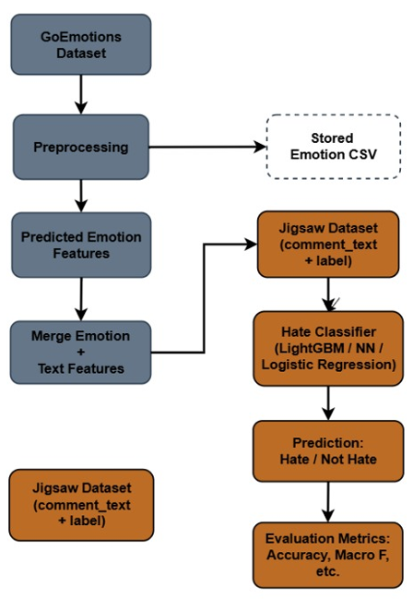
FLOW DIAGRAM
Review No.2
Batch No. CG8

Slide 11
Implementation WorkFlow
1. Data Collection
Downloaded GoEmotions (for emotion labels) and Jigsaw Toxic Comments (for hate detection).
Converted GoEmotions to single-label format and prepared Jigsaw for binary classification.
2. Preprocessing
Cleaned text by lowercasing, removing emojis/non-ASCII chars, extra spaces, and punctuation noise.
Tokenized using model-specific tokenizers and removed null or empty entries.
3. Exploratory Data Analysis (EDA)
Inspected class distributions, common tokens, and emotion–hate overlaps.
Visualized before/after cleaning stats and identified imbalance issues.
Review No.02
Batch No. CG8

Slide 12
4. Data Balancing
Applied SMOTE to the Jigsaw dataset to correct hate vs non-hate class imbalance.
Verified balanced class distribution before training hate classifiers.
5. Emotion Model Training
Trained multiple emotion classifiers (BERT, DistilBERT, DistilRoBERTa, LightGBM, FastText) on GoEmotions.
Saved both predicted emotion labels and emotion logits for each example.
6. Feature Extraction & Integration
Extracted emotion logits and one-hot emotion labels from the best emotion models.
Merged these emotion features with original text features in the Jigsaw dataset.
Review No.02
Batch No. CG8

Slide 13
7. Hate Classifier Training
Trained hate detection models (LightGBM, Feedforward NN, Logistic Regression) on the enriched dataset.
Tuned hyperparameters (AdamW, lr=2e-5, batch size=16, epochs 3–5) for best performance.
8. Evaluation & Analysis
Measured Accuracy, Macro F1, and confusion matrices; performed paired significance tests.
Compared emotion-calibrated models vs text-only baselines and tested cross-domain on HateXplain.
9. Interpretability & Insights
Linked emotion signals (e.g., anger, disgust) to hate predictions to explain model decisions.
Produced confusion matrices and class-wise reports to highlight strengths and weaknesses.
Review No.02
Batch No. CG8

Slide 14
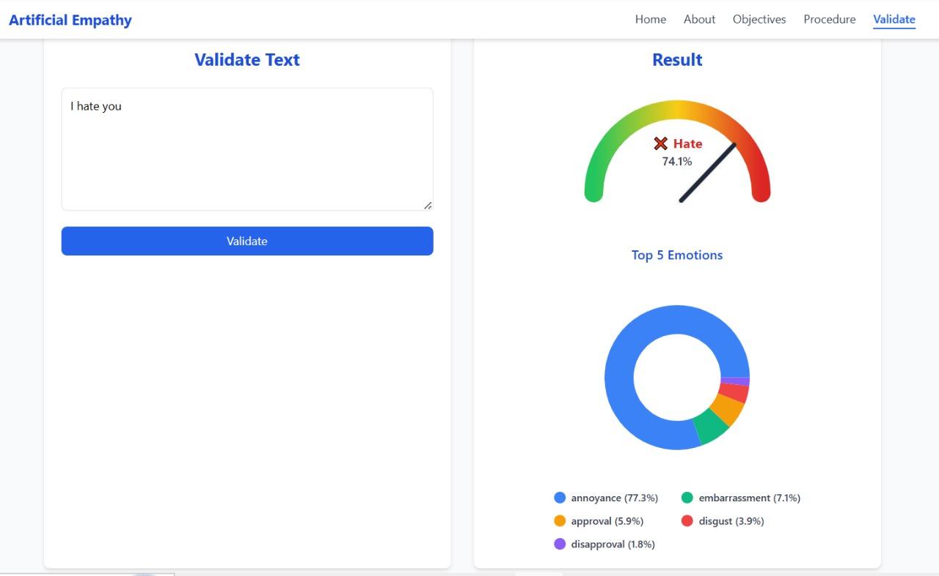

Slide 15
RESULTS & ANALYSIS
Emotion Model | Hate Classifier | Accuracy (%) | Macro F1-score
BERT | LightGBM | 94.20 | 0.7410
BERT | BERT (reused) | 91.10 | 0.9110
LightGBM | LightGBM (self) | 89.91 | 0.6200
FastText | FastText | 93.41 | 0.5154
DistilRoBERTa | DistilRoBERTa | 96.16 | 0.8800
Review No.02
Batch No. CG8
Batch No.

Slide 16
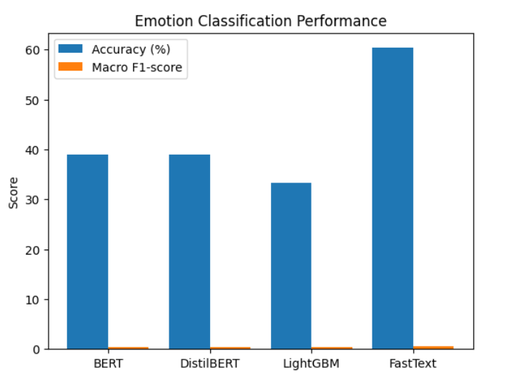
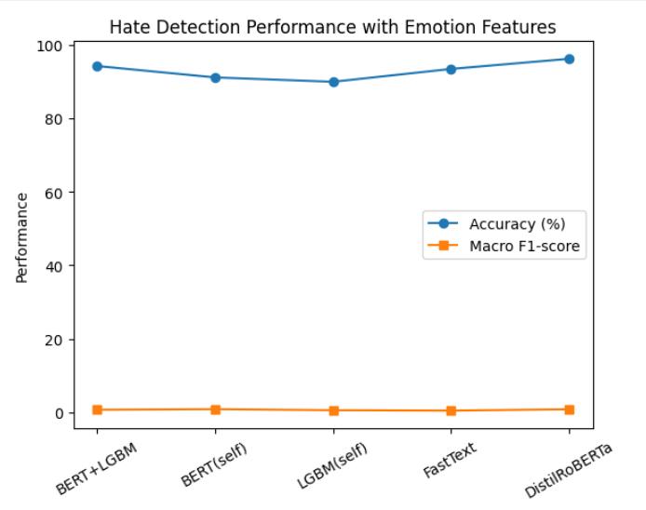
RESULTS & ANALYSIS
Review No.02
Batch No. CG8
Batch No.

Slide 17
CONCLUSION
Our project successfully improved hate speech detection by integrating emotional features with text-based inputs.
The emotion-calibrated framework achieved higher accuracy and detected subtle, indirect hate more effectively.
This approach also enhanced model interpretability by linking emotional cues to predictions.
Overall, the system provides a more reliable and context-aware solution for online content moderation.
05-12-2025
Review No.02
Batch No. CG8

Slide 18
FUTURE SCOPE
The system can be extended to multilingual datasets and real-time moderation platforms.
Future improvements may include multimodal analysis using emojis, audio tone, or images.
Bias mitigation and explainable AI techniques can further increase fairness and transparency.
05-12-2025
Review No.02
Batch No. CG8

Slide 19
REFERENCES
Aubaid et al., Machine Learning and Rule-Based Techniques for Text Classification, IJSAEM, 2024.
Ahmed et al., Deep Learning-Based NLP in Human–Agent Interaction, NLP Journal, 2024.
Naznin et al., Hierarchical Sentiment-Based Hate Speech Detection, arXiv, 2024.
Mathew et al., HateXplain: Explainable Hate Speech Detection, AAAI, 2021.
Devlin et al., BERT: Pre-training of Deep Bidirectional Transformers, NAACL, 2019.
Review No.02
Batch No.CB2

Slide 20

Review No.02
Batch No.CG8

Slide 21

Review No.02
Batch No.CG8

